Slide 1
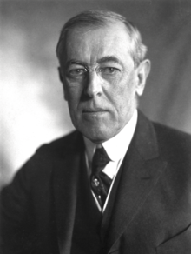
Who is this?
Notes:
Woodrow Wilson

Slide 2
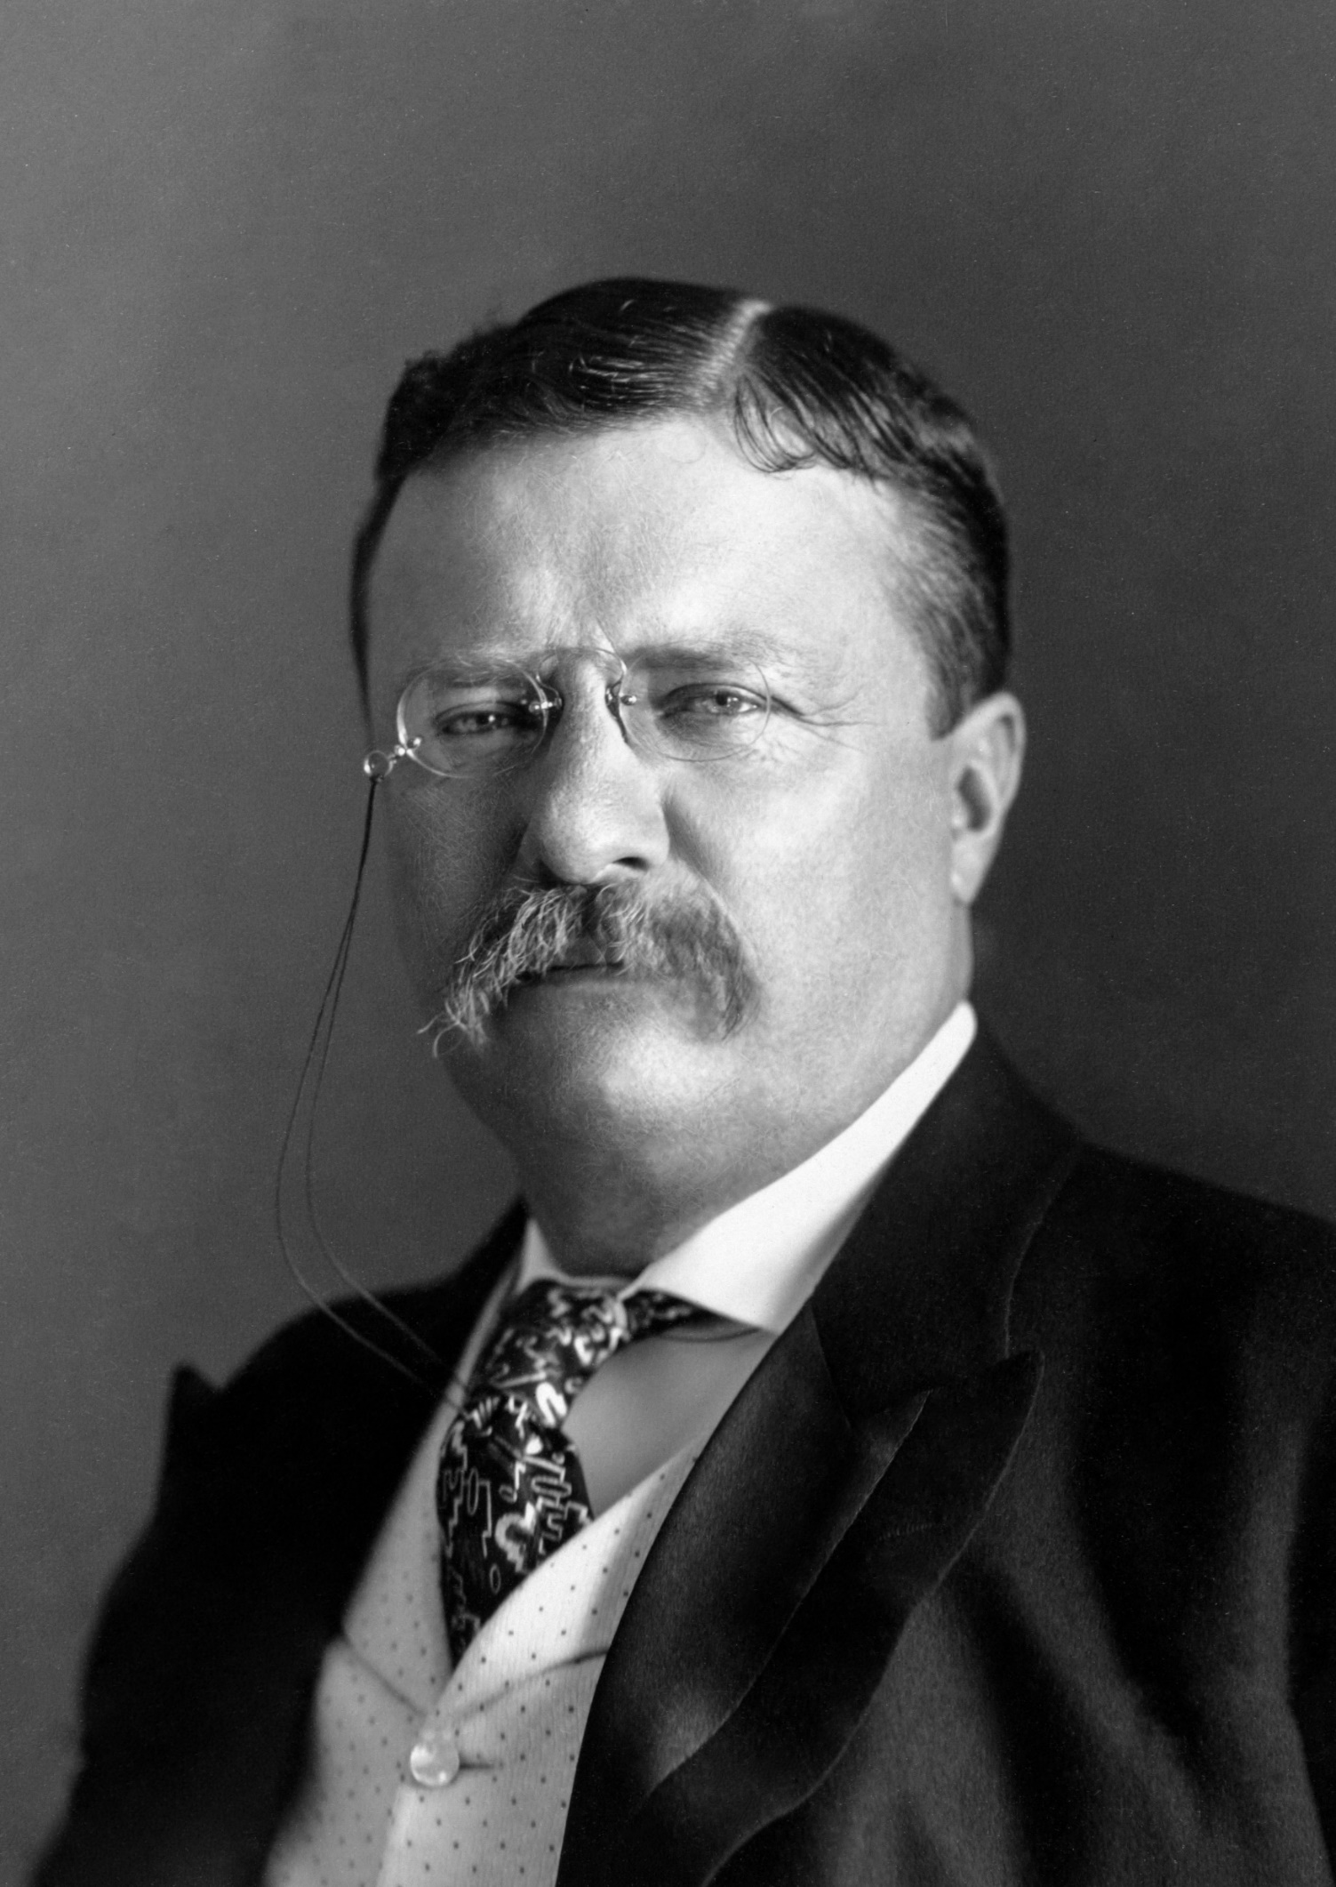
Who is this?
Notes:
Theodore Roosevelt

Slide 3
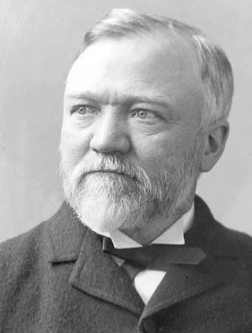
Who is this?
Notes:
Andrew Carnegie

Slide 4
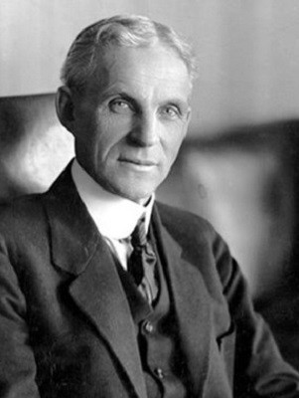
Who is this?
Notes:
Henry Ford

Slide 5
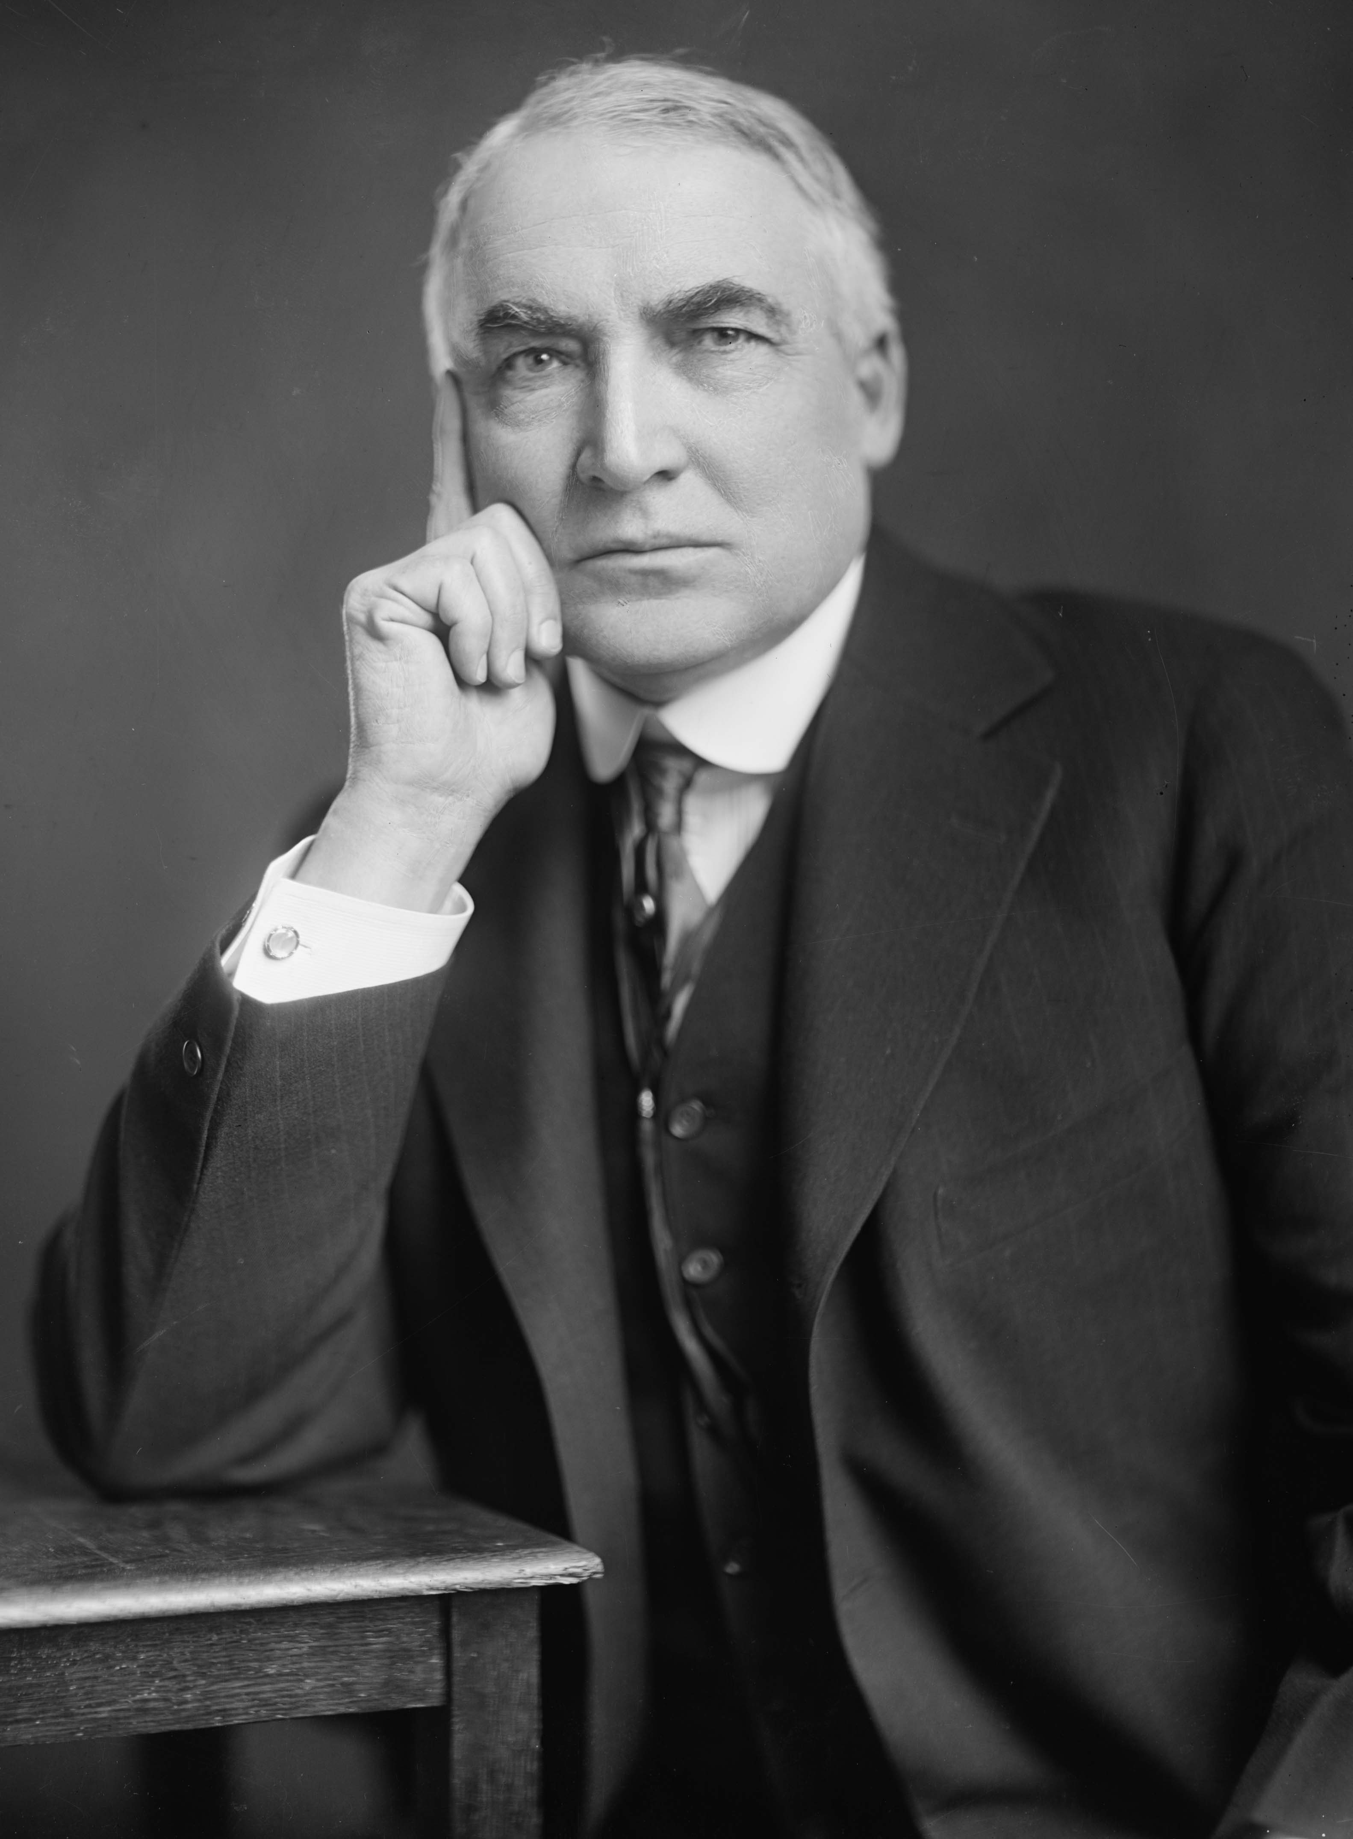
Who is this?
Notes:
Warren Harding

Slide 6
“Return to Normalcy.” -Harding

Slide 7
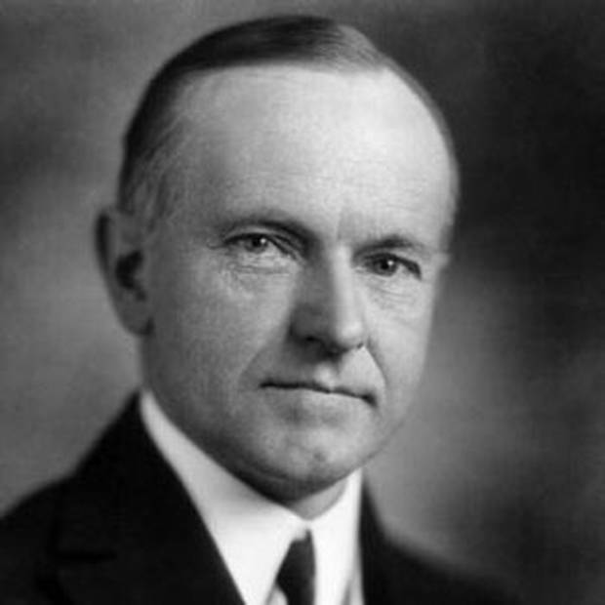
Who is this?
Notes:
Calvin Coolidge

Slide 8
“After all, the chief business of the American people is business.”
– Coolidge

Slide 9

1920s Republican Presidents
https://www.youtube.com/watch?v=UbcpxEGhPzI&t=28s

Slide 10

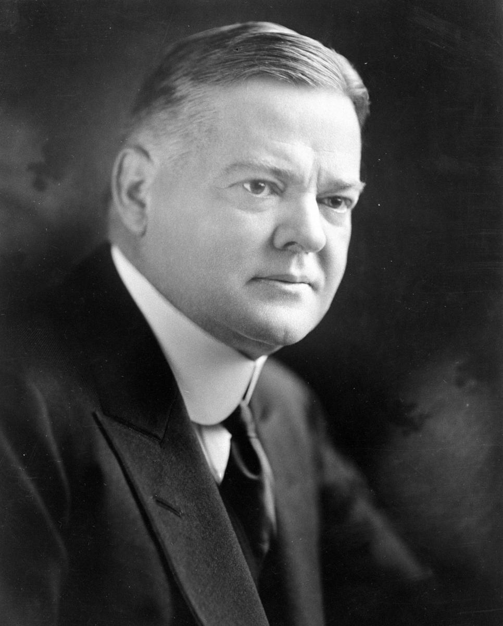
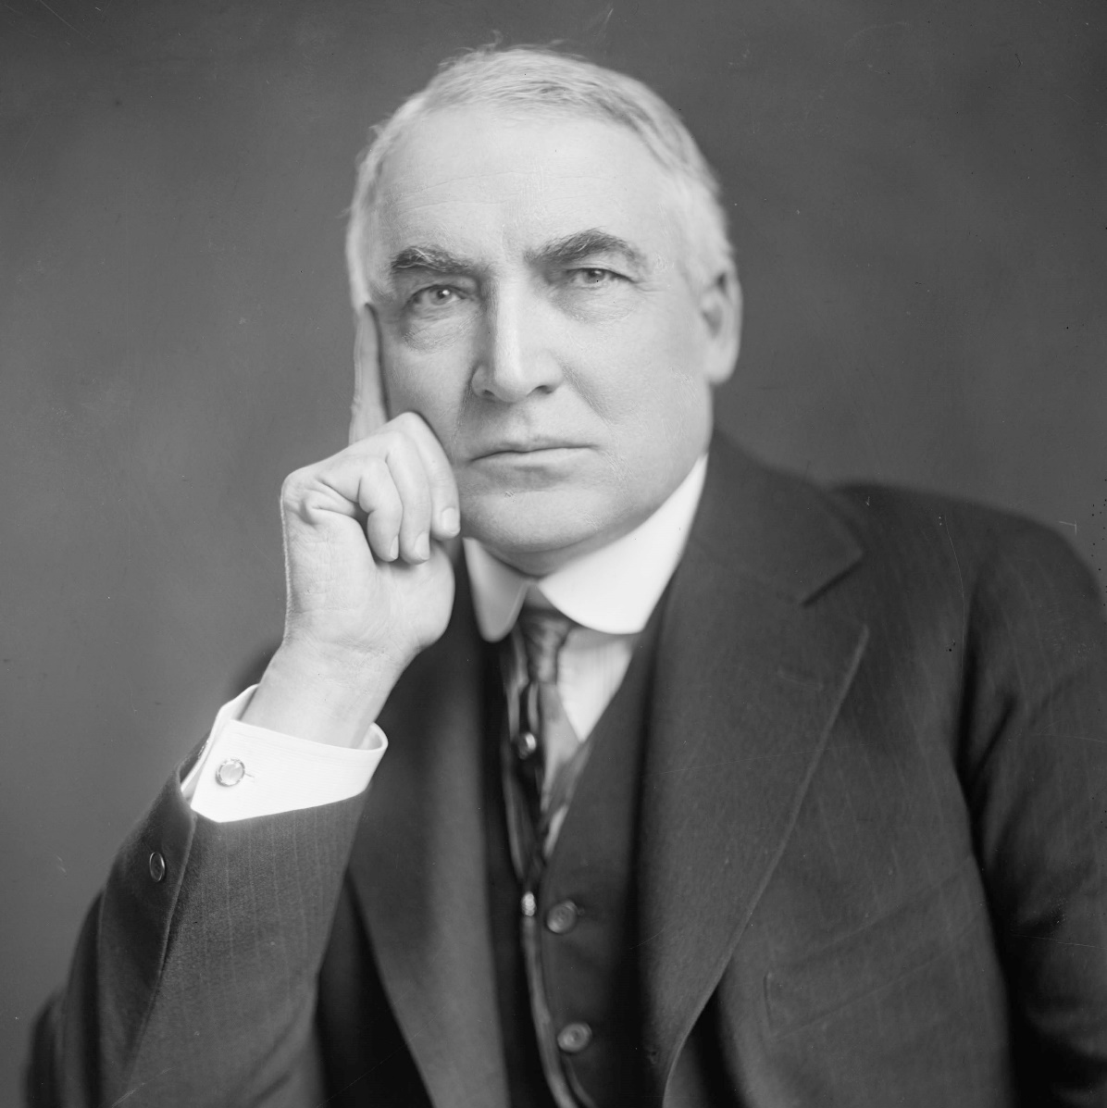
The Republican Decade
Between 1921 and 1933 US dominated by three Republican Presidents.
Warren Harding 1921-1923
Calvin Coolidge 1923-1929
Herbert Hoover 1929-1933

Slide 11
Warren Harding
He believed in:
Higher tariffs on imported goods
Lower taxes on business and private income
Fewer immigrants
More farm aid
Rejection of the League of Nations
A return to laissez-faire politics
Presidency marred by scandals and allegations of corruption.
Considered one of the worst Presidents in American history.
Teapot Dome Scandal: bribery to lease federal oil reserves that were set aside for emergency use only.

Slide 12
Calvin Coolidge
He believed in:
Minimal government intervention
Only role of the government was to:
Balance the budget
Reduce debt
Cut taxes
Make easy credit available
Known as ‘Silent Cal’ because of his refusal to engage in small talk.

Slide 13
Herbert Hoover
President during Wall Street Crash and ensuing Great Depression.
Doomed to fail?
Firm believer in ‘rugged individualism’.

Slide 14
Laissez-faire
The idea that it was not the responsibility of government to be involved in social and economic issues.
This allowed businesses to expand without restriction.
Harding and Coolidge believed it was not the function of government to interfere in peoples’ lives.
Businesses left alone to organise their own affairs and workers free to bargain for wages in workplaces.

Slide 15
‘Rugged individualism’
The term used to describe the American view that people achieved success by their own hard work and effort.

Slide 16
